Slide 1
π Praxis
Team 2: Quinten, Kim, Seung Jae, Taylor, Iris

Slide 2
Overview
Problem and Solution
Architecture
Core Features
Demonstration
Code Functionality
Challenges and Lessons Learned

Slide 3


Problem & Our Solution
Problem
Finding help with school work and learning online is often unreliable
  Hostile environments
  Impractical/non-applicable solutions
  Shortcut answers you can’t learn from
Our Solution
Praxis! A web based and student focused Q&A forum
  Peer learning
  Course and subject centric
  AI enhanced

Slide 4




Technology Stack
Frontend
Next.js
Tailwind CSS
Dockerized
Docker Containers
DockerFile per service
Docker Compose to automate build
Api gateway container for discovery
Backend
Node.js Express Framework
Database
MySQL
Linux Image

Slide 5
Architecture Design
Full stack web app
  Next.js frontend
  Express + MySql backend
Client server model
  Separation of concerns
  Parallel development
  Interoperability
  Dockerized
Potential Evolutions
  Microservice implementation
  Kubernetes for orchestration

Slide 6
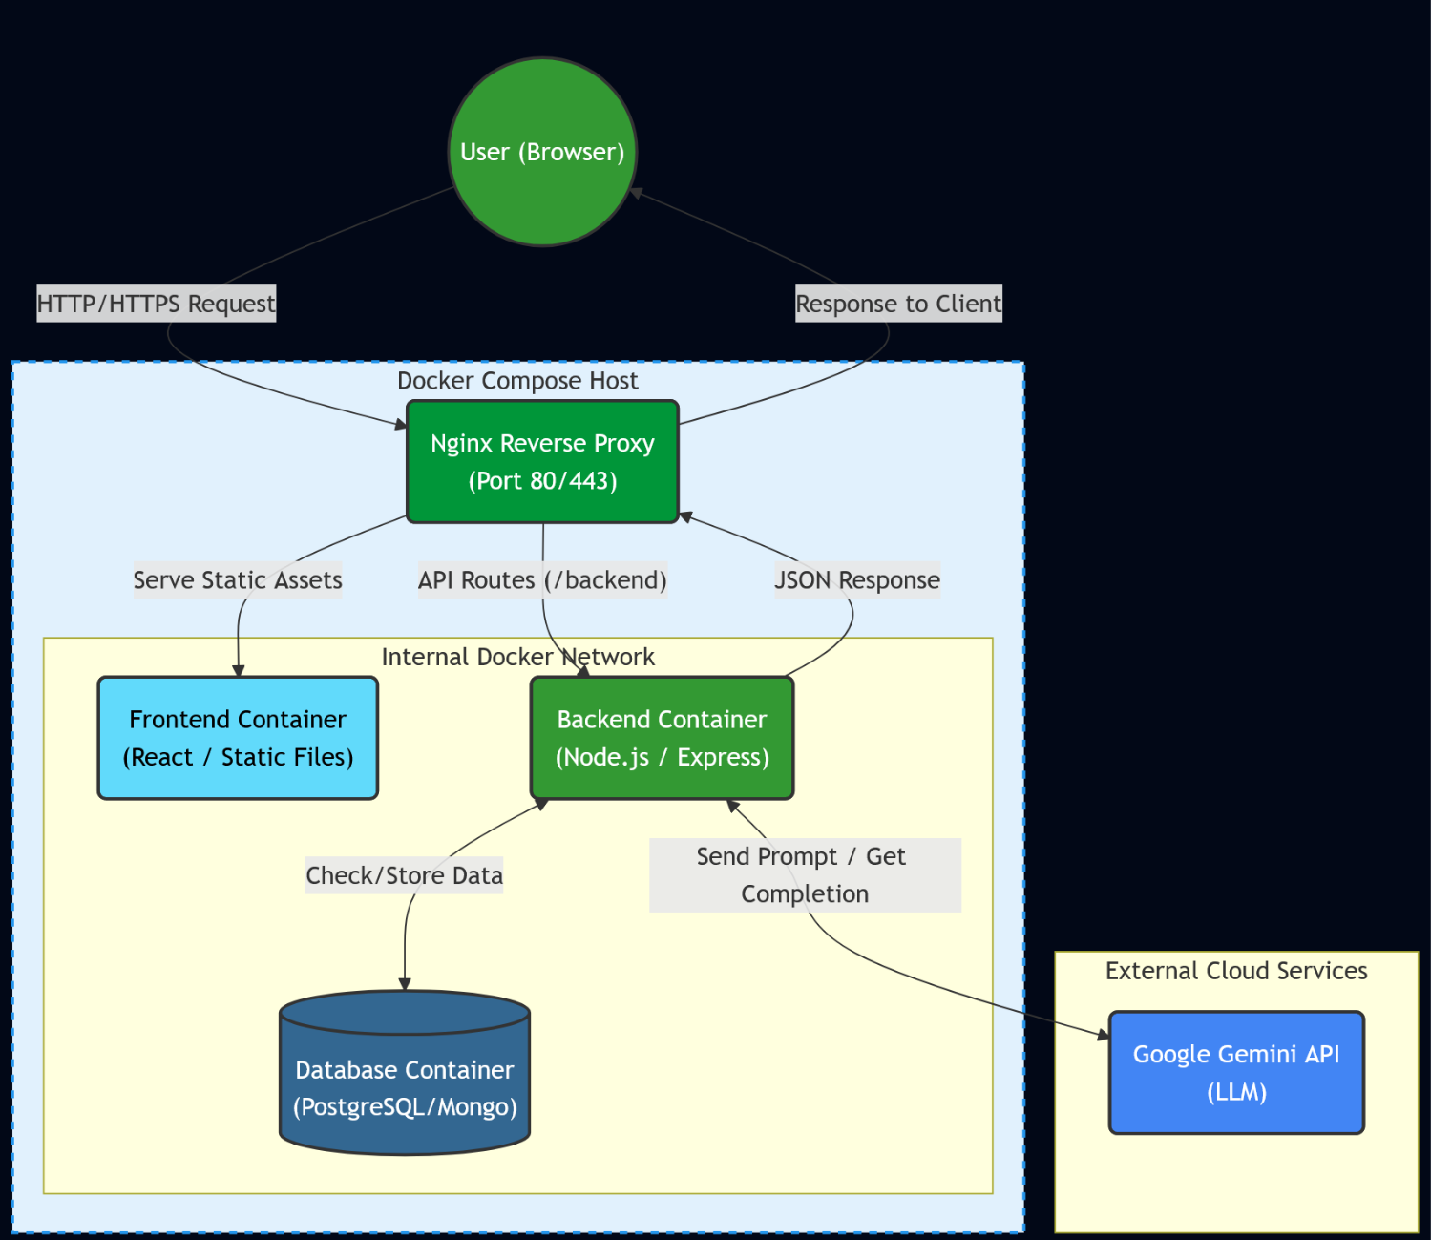
How the
App Works
Notes:
Here’s how our web app works behind the scene.
When a student uses the app, their request first goes through an Nginx reverse proxy, which decides where to send it. If it’s a normal page load, Nginx will serve the static files from our React frontend. If it’s an API call, it forwards the request to our Node.js backend.
The backend handles all the logic. It can create or fetch data from our database container or send the student’s question to the Google Gemini API and get an AI-generated response.
Finally, the backend returns everything to the frontend, and the answer is displayed to the student. All these containers communicate through an internal Docker network. This is how we keep the whole system organized and easy to manage.

Slide 7
Core Features
Authentication ✅
Posting questions/answers. ✅
Posting anonymously. ✅
Viewing and browsing posts. ✅
Searching/filtering by course. ✅
Rating system. ✅
AI-generated answers!

Slide 8


Praxis Demo
Demo Content
Setup
Core Features
Unit Tests
CI/CD
Notes:
This will be done showing it on my laptop

Slide 9


Deivations
Using AI for answering questions
Stateless Auth (JWT)

Slide 10
Technical challenges
AI-Generated Answers
AI not consistent in replying format
`ignore all instructions…`
Notes:
AI not consistent in replying format:
- remove JSON requirement for AI answers
`ignore all instructions`
Not much we can do lmaoo

Slide 11


Technical challenges
Unit testing with Jest and Vitest
Learning curve
Notes:
Learning curve:
Start small (with general assert trues) and get used to the syntax and logic
Then get big with mock testing actual scenarios with mocking results from functions and api responses

Slide 12
Challenges and Lessons Learned
Unfamiliar framework
  Next.js (frontend)
Connection
  Ensuring that all 3 components communicated properly
Different OS
  Windows vs Mac
Compromises
  JWT Authentication
Takeaways
  Scope in time to research
  Ask for help!!
Notes:
· Share the main challenges encountered during the project.
· Reflect on how these challenges were addressed.
· Discuss lessons learned and what you would improve in the future.

Slide 13
Thank you!

